Slide 1
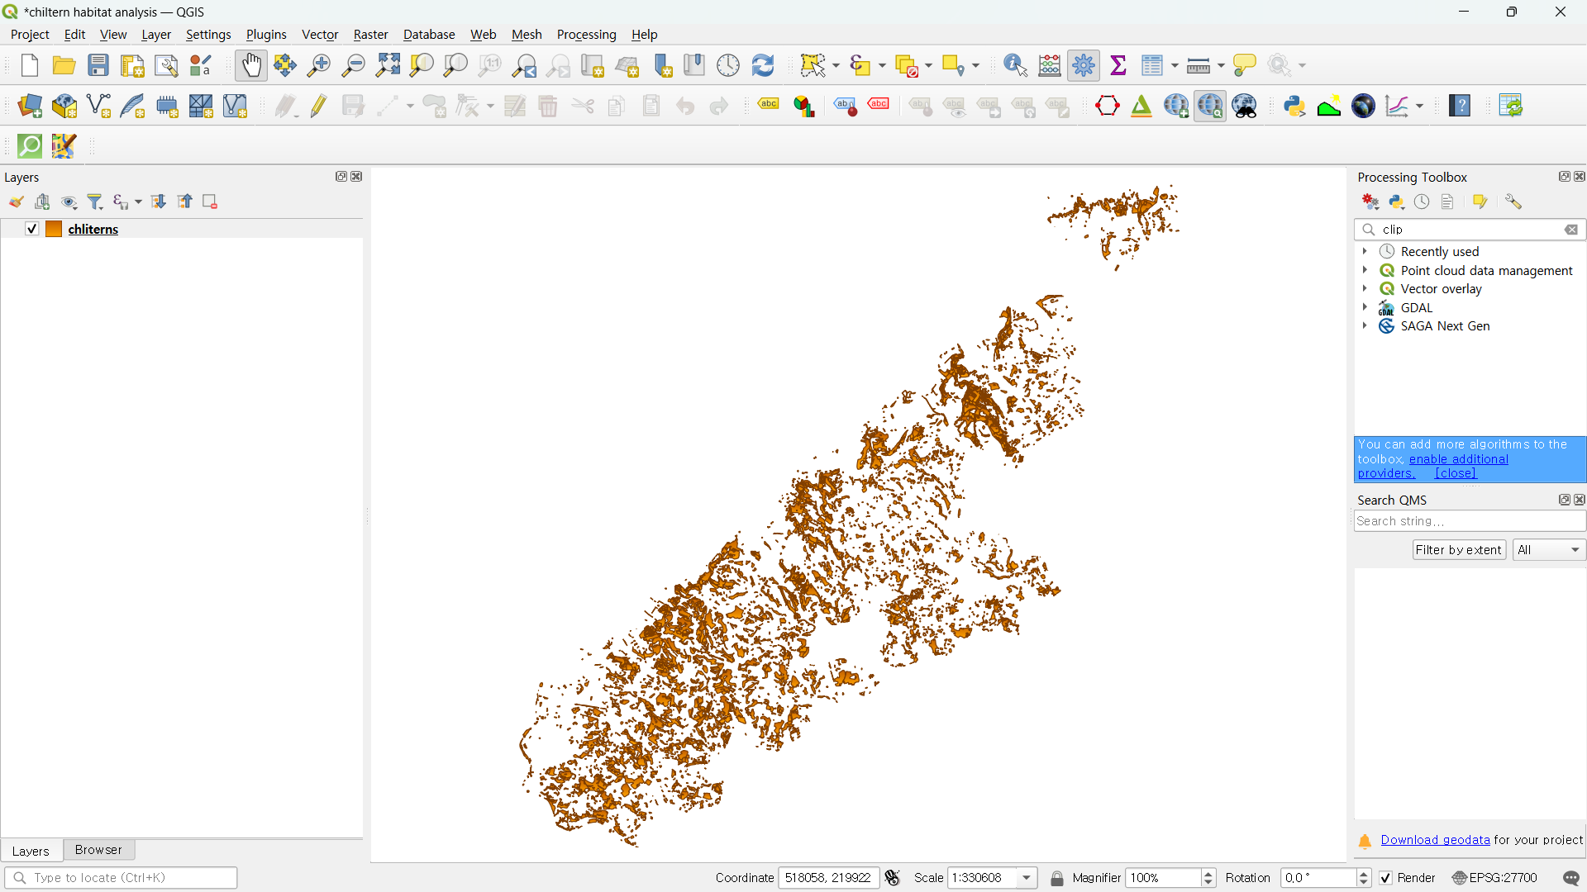
Biodiversity Net Gain Assessment on Chiltern Area of Outstanding Natural Beauty

Slide 2
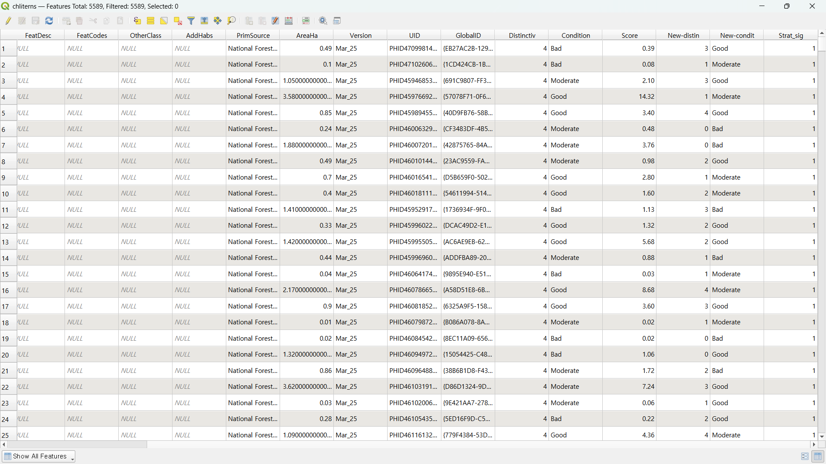
1. Make new fields in the habitat data acquired from data portals on given portion of land that is relevant to BNG Assessment.
(Distinctiveness, Condition, Baseline Score, Post dev Distinctiveness, Post dev condition, Post dev score etc)

Slide 3
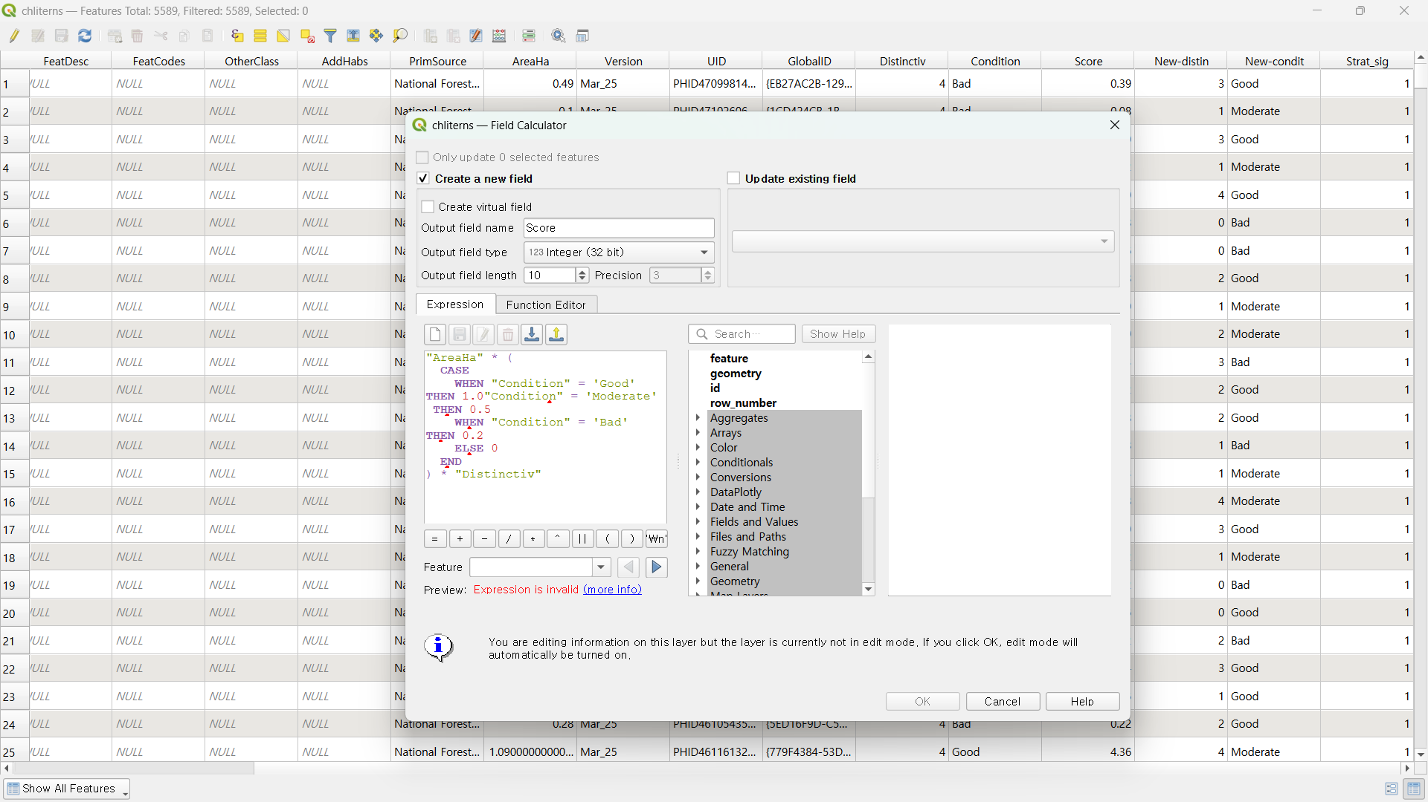

For distinctiveness of a land patch on a site, you normally assign a value for each type of habitat for that land patch, however for the sake of simulation I just assigned 4 for DWOOD, 3 for LCGRA, 2 for LFENS, 1 for LHEAT and 0 for all the other habitats. I also assigned random condition values(Good, moderate and bad) for each patch of land, which in real life you would undertake an in depth field survey. Same to the post-dev conditions and distinctiveness. For the real BNG assessment you would do an on-site survey to determine the pre and post development conditions of the site.

Slide 4
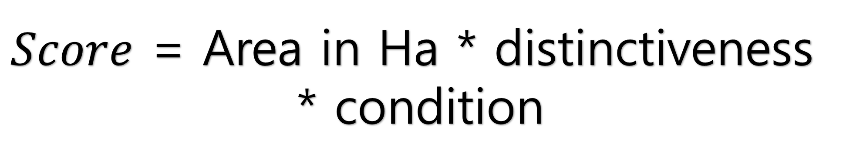
$Score$ = Area in Ha * distinctiveness
* condition
Above is the formulae for calculating the baseline(pre-dev) score for a given patch of land. Same goes for the post-dev score, but with Connectivity and Strategic Significance additionally multiplied. In this simulation I standardized the Strategic Significance values to 1 for all land patches. Then I added up baseline and post-dev scores separately for all the land patches within the site of interest.

Slide 5
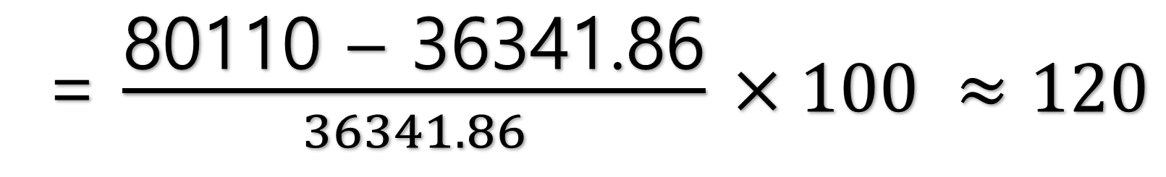
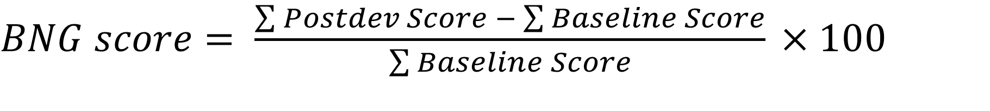
$BNG score= \frac{\sum{Postdev Score −}\sum{Baseline Score}}{\sum{Baseline Score}}$ $×100$
= $\frac{\text{80110 – 36341.86}}{36341.86}$ $×100 ≈120$
There was approximately 20% increase in the ecological value after development, which is good!

Slide 6
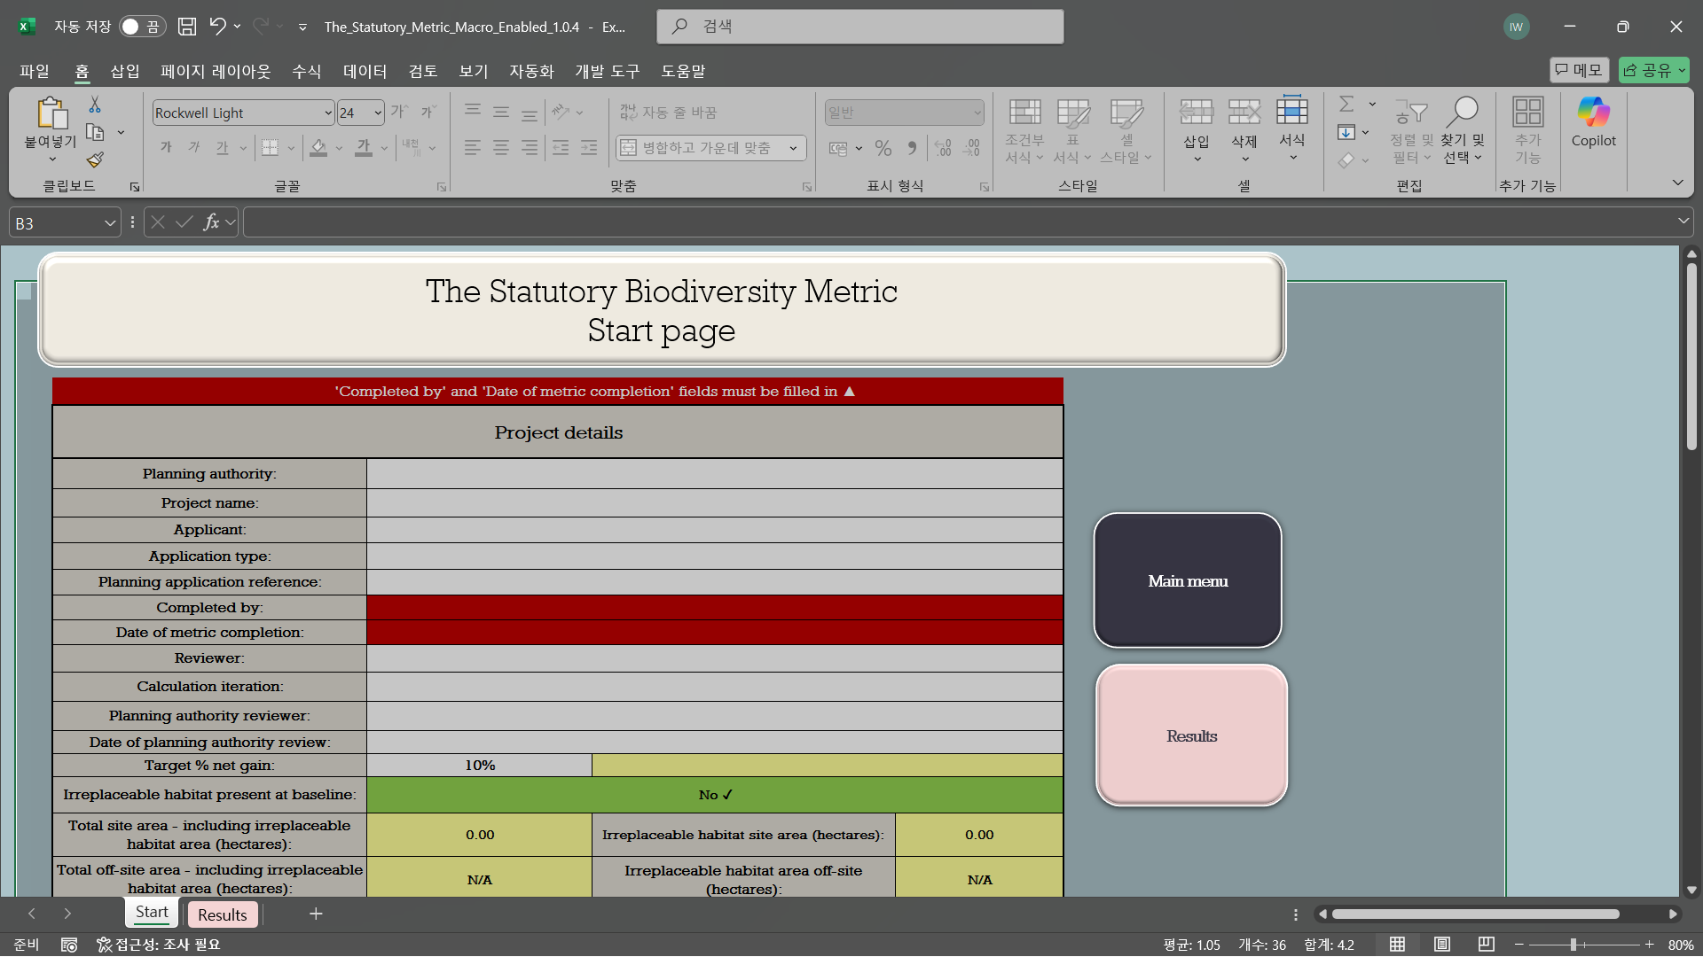
* I was actually going to use this macro made by the UK government to calculate the BNG score for the given site, but decided to have a go at going through the whole simplified procedure of BNG score calculation partly because the metric was much more complex.

Slide 7
Thank you!

